Slide 1
Displaying Data from Multiple Tables Using Joins
6

Slide 2
Objectives
After completing this lesson, you should be able to do the following:
Write SELECT statements to access data from more than one table using equijoins and non-equijoins
Join a table to itself by using a self-join
View data that generally does not meet a join condition by using OUTER joins
Generate a Cartesian product of all rows from two or more tables

Slide 3
Lesson Agenda
Types of JOINS and its syntax
Natural join:
USING clause
ON clause
Self-join
Nonequijoins
OUTER join:
LEFT OUTER join
RIGHT OUTER join
FULL OUTER join
Cartesian product
Cross join

Slide 4

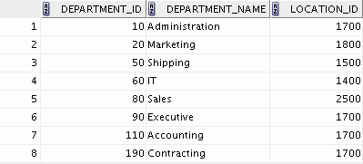

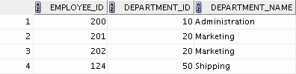

Obtaining Data from Multiple Tables
EMPLOYEES
DEPARTMENTS
…
…

Slide 5
Types of Joins
Joins that are compliant with the SQL:1999 standard include the following:
Natural joins:
NATURAL JOIN clause
USING clause
ON clause
OUTER joins:
LEFT OUTER JOIN
RIGHT OUTER JOIN
FULL OUTER JOIN
Cross joins

Slide 6
Joining Tables Using SQL:1999 Syntax
Use a join to query data from more than one table:
SELECT FROM
table1.column, table2.column table1
[NATURAL JOIN table2] |
[JOIN table2 USING (column_name)] | [JOIN table2
ON (table1.column_name = table2.column_name)]| [LEFT|RIGHT|FULL OUTER JOIN table2
ON (table1.column_name = table2.column_name)]| [CROSS JOIN table2];

Slide 7
Creating Natural Joins
The NATURAL JOIN clause is based on all the columns in the two tables that have the same name.
It selects rows from the two tables that have equal values in all matched columns.
If the columns having the same names have different data types, an error is returned.

Slide 8
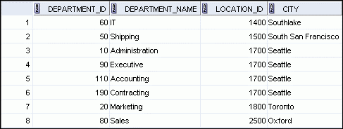
Retrieving Records with Natural Joins
SELECT department_id, department_name, location_id, city FROM departments
NATURAL JOIN locations | ;

Slide 9
Creating Joins with the USING Clause
If several columns have the same names but the data types do not match, use the USING clause to specify the columns for the join.
Use the USING clause to match only one column

Slide 10
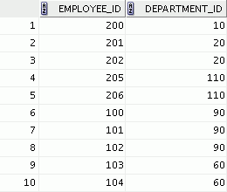
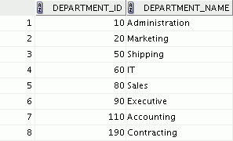
Joining Column Names
EMPLOYEES
DEPARTMENTS
…
Primary key
Foreign key

Slide 11
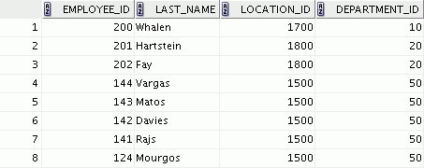
Retrieving Records with the USING Clause
SELECT employee_id, last_name, location_id, department_id FROM employees JOIN departments
USING (department_id) | ;
…

Slide 12
Creating Joins with the ON Clause
Use the ON clause to specify columns to join.
The ON clause makes code easy to understand.
The join condition is separated from other search conditions.

Slide 13
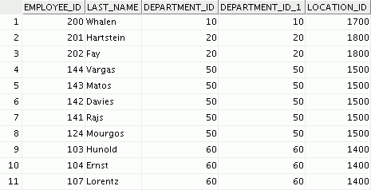
Retrieving Records with the ON Clause
SELECT e.employee_id, e.last_name, e.department_id, d.department_id, d.location_id FROM employees e JOIN departments d
ON (e.department_id = d.department_id);
…

Slide 14
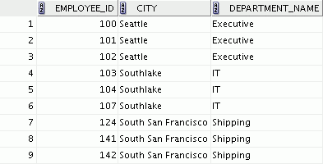
Creating Three-Way Joins with the ON Clause
SELECT employee_id, city, department_name FROM employees e
JOIN departments d ON d.department_id = e.department_id JOIN locations l ON d.location_id = l.location_id;
…

Slide 15
Applying Additional Conditions to a Join
Use the AND clause or the WHERE clause to apply additional conditions:
SELECT e.employee_id, e.last_name, e.department_id, d.department_id, d.location_id FROM employees e JOIN departments d ON (e.department_id = d.department_id)
AND e.manager_id = 149 | ;
Or
SELECT e.employee_id, e.last_name, e.department_id, d.department_id, d.location_id FROM employees e JOIN departments d ON (e.department_id = d.department_id)
WHERE e.manager_id = 149 | ;

Slide 16
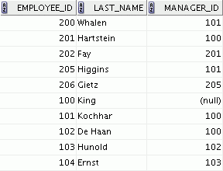
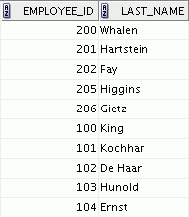
Joining a Table to Itself
EMPLOYEES (WORKER)
EMPLOYEES (MANAGER)
…
…
MANAGER_ID in the WORKER table is equal to
EMPLOYEE_ID in the MANAGER table.

Slide 17
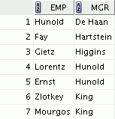
Self-Joins Using the ON Clause
SELECT worker.last_name emp, manager.last_name mgr FROM employees worker JOIN employees manager
ON (worker.manager_id = manager.employee_id);
…

Slide 18
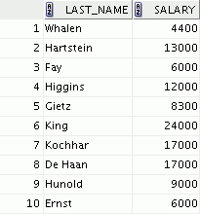
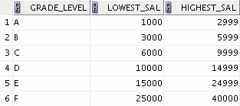

Nonequijoins
EMPLOYEES
JOB_GRADES
The JOB_GRADES table defines the LOWEST_SAL and HIGHEST_SAL range of values for each GRADE_LEVEL. Therefore, the GRADE_LEVEL column can be used to assign grades to each employee.
…

Slide 19
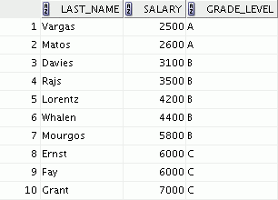
Retrieving Records with Nonequijoins
SELECT e.last_name, e.salary, j.grade_level FROM employees e JOIN job_grades j
ON e.salary
BETWEEN j.lowest_sal AND j.highest_sal;
…

Slide 20
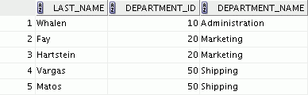
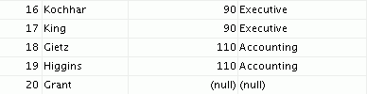
LEFT OUTER JOIN
SELECT e.last_name, e.department_id, d.department_name
FROM employees e ON
LEFT OUTER JOIN
departments d
(e.department_id = d.department_id) ;
…

Slide 21
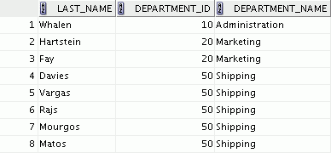

RIGHT OUTER JOIN
SELECT e.last_name, d.department_id, d.department_name FROM employees e RIGHT OUTER JOIN departments d
ON (e.department_id = d.department_id) ;
…

Slide 22
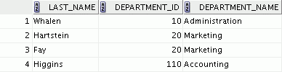
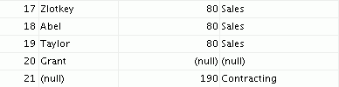
FULL OUTER JOIN
SELECT e.last_name, d.department_id, d.department_name
FROM employees e ON
FULL OUTER JOIN
departments d
(e.department_id = d.department_id) ;
…

Slide 23
Cartesian Products
A Cartesian product is formed when:
A join condition is omitted
A join condition is invalid
All rows in the first table are joined to all rows in the second table
Always include a valid join condition if you want to avoid a Cartesian product.

Slide 24
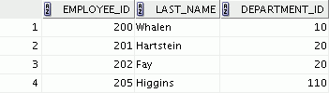
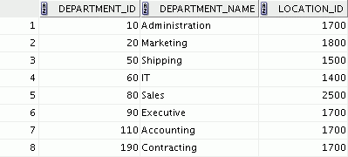




Generating a Cartesian Product
EMPLOYEES (20 rows)
DEPARTMENTS (8 rows)
…
Cartesian product: 20 x 8 = 160 rows
…
…

Slide 25
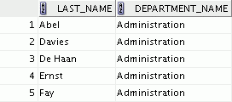

Creating Cross Joins
The CROSS JOIN clause produces the cross-product of two tables.
This is also called a Cartesian product between the two tables.
SELECT last_name, department_name FROM employees
CROSS JOIN departments ;
…

Slide 26
Summary
In this lesson, you should have learned how to use joins to display data from multiple tables by using:
Equijoins
Nonequijoins
OUTER joins
Self-joins
Cross joins
Natural joins

Slide 27
Practice 6: Overview
This practice covers the following topics:
Joining tables using an equijoin
Performing outer and self-joins
Adding conditions

